Slide 1
HOSPITAL MANAGEMENT
Compiled by- MANVI AGARWAL-209202143

Slide 2
INTRODUCTION:
Hospitals have to maintain the medical records of their patients, manage their staff and its multiple departments. These data related problems can be solved by creating RDBMS solution.
Assigning the unique IDs to the patients and store the relevant information .
Secondly adding the information about the hospital’s doctors.
At last, patients would get admitted into rooms, so adding that information in the database too.
Apart from that adding the information of ward boys and nurses working in the hospital and assigned to different rooms.

Slide 3
SYNOPSIS AND PURPOSE
The software is for the automation of hospital management.
It can be used in any hospital, clinic or dispensary for maintaining the patient details, booking appointments and checking the availability.
It even maintains the doctor records, staff details and the billing system as well which in turn reduces the wastage of time.

Slide 4
PROJECT REQUIREMENTS:
Hardware Requirements –
Processor- i3,
Operating System- Windows 7 minimum
Minimum 8GB RAM

Slide 5
Continued….
SOFTWARE REQUIREMENTS:
Oracle Application Express- Database connectivity and management
Adobe Photoshop- Logo and designing user interfaces

Slide 6
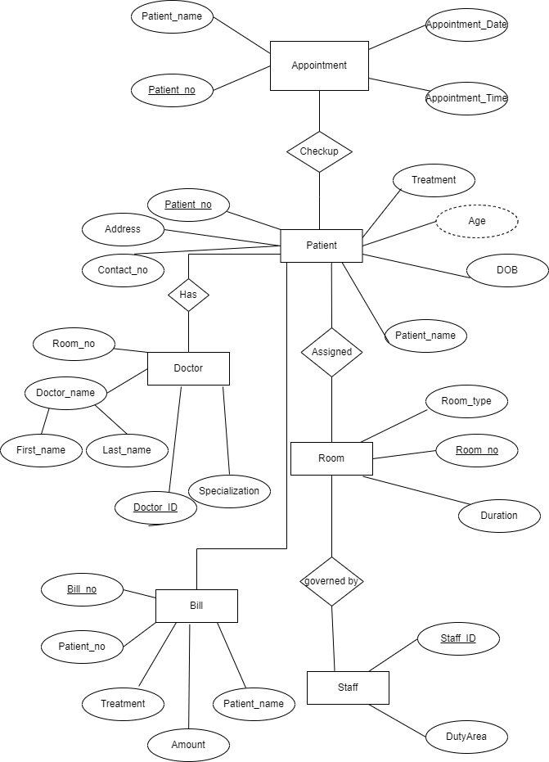
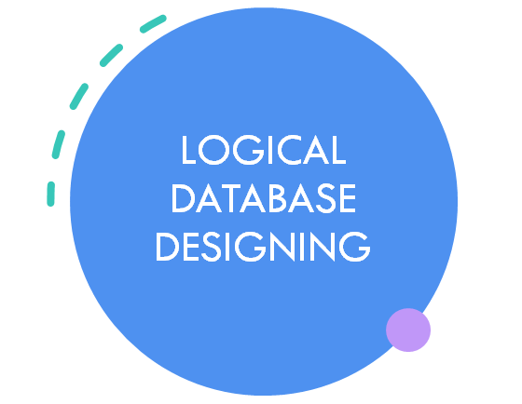
ER DIAGRAM:

Slide 7
Appointment table
 | Patient_no | Patient_name | Appointment_Time | Appointment_Date
1.
2.
3.
4.

Slide 8
PATIENT TABLE
 | Patient_no | Patient_name | DOB | Age | Treatment | Address | Contact_no
1.
2.
3.
4.

Slide 9
DOCTOR TABLE
 | Doctor_ID | Doctor_name | Specialization | Room_no
1.
2.
3.
4.

Slide 10
Room table
 | Room_no | Room_type | Duration
1.
2.
3.
4.

Slide 11
STAFF TABLE
 | Staff_ID | DutyArea
1.
2.
3.
4.

Slide 12
BILL TABLE
 | Bill_no | Patient_no | Patient_name | Treatment | Amount
1.
2.
3.
4.

Slide 13
Gantt CHART:
Topic/Weeks | March 2nd | March 3rd | March 4th | April 1st | April 2nd
Title Submission | Done
Addressing the problems |  | Done
Finding Solutions |  |  | Done
Introduction |  |  |  | Done
ER Diagram |  |  |  | Done
Tables Creation |  |  |  |  | Done

Slide 14
CONCLUSION
The hospital management system is an automated system. The database stores all the relevant information in an easy and effective way.
It provides appointment details, patient’s info including the treatment he is going through.
Moreover it includes the particulars of doctors and staff data as well.
Lastly it has an excellent computerized billing facility.

Slide 15


